Slide 1
A Review-aware Graph
Contrastive Learning Framework
for Recommendation
Advisor : Jia-Ling, Koh
Speaker : Hsiao-Ting Huang
Source : SIGIR’22
Date : 2022/09/20

Slide 2
Outline
● Introduction
● Related Work
● Method
● Experiment
● Conclusion

Slide 3
Introduction
Review-based recommendation :
user and item embedding learning

Slide 4
Introduction
Review-based recommendation :
user and item embedding learning

Slide 5
Introduction
Review-based recommendation :
user and item embedding learning
predict rating
?

Slide 6
Introduction
GC-MC:Graph Convolutional Matrix Completion
Notes:
將評分矩陣轉換乘bipartite graph，在用graph auto encoder

Slide 7
Introduction
GC-MC:Graph Convolutional Matrix Completion

Slide 8
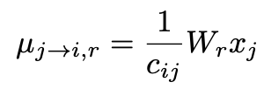
Introduction
GC-MC:Graph Convolutional Matrix Completion

Slide 9
Outline
● Introduction
● Related Work
● Method
● Experiment
● Conclusion

Slide 10
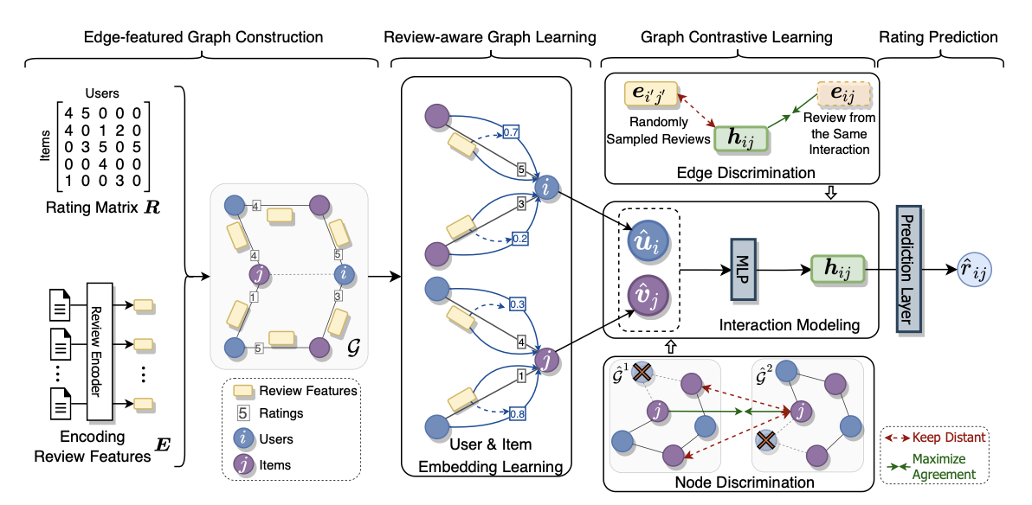
framework

Slide 11
Edge-featured Graph Construction
U₁
U₂
U₃
I₁
U₁
I₁
I₂
I₃
I₂
U₂
U₃
I₃

Slide 12
Edge-featured Graph Construction
U₁
U₂
U₃
I₁
U₁
I₁
I₂
I₃
I₂
U₂
U₃
I₃

Slide 13
Edge-featured Graph Construction
U₁
U₂
U₃
I₁
U₁
I₁
I₂
I₃
I₂
U₂
U₃
I₃

Slide 14
Edge-featured Graph Construction
U₁
U₂
U₃
I₁
U₁
I₁
I₂
I₃
I₂
U₂
U₃
I₃

Slide 15
2.1 Review-Aware Message Passing
treat rating score as edge type to distinguish the semantics carried by ratings
if r=5
review representation
neighbor
node (item)
central
node (user)
User Embedding Learning

Slide 16
2.1 Review-Aware Message Passing
treat rating score as edge type to distinguish the semantics carried by ratings
if r=5
review representation
neighbor
node (item)
central
node (user)
User Embedding Learning

Slide 17
2.1 Review-Aware Message Passing
treat rating score as edge type to distinguish the semantics carried by ratings
if r=5
review representation
neighbor
node (item)
central
node (user)
User Embedding Learning

Slide 18
2.1 Review-Aware Message Passing
if r=4
review representation
neighbor
node (user)
central
node (item)
Item Embedding Learning

Slide 19
2.2 Message Aggregation
aggregate all messages together to generate user and item embeddings
r=1~5
item set
user set

Slide 20
2.2 Message Aggregation
By stacking 𝐿 layers of message passing and aggregation

Slide 21
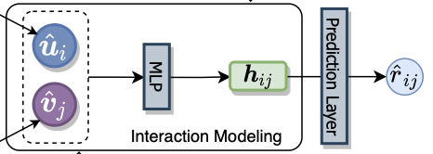
2.3 Interaction Modeling
MLP(.) = 2 hidden layer + GELU

Slide 22
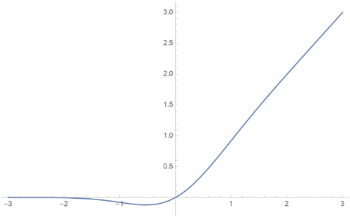
2.3 Interaction Modeling
MLP(.) = 2 hidden layer + GELU
GELU(x) = xP(X ≤ x) = xΦ(x)

Slide 23
2.3 Interaction Modeling
loss function :

Slide 24
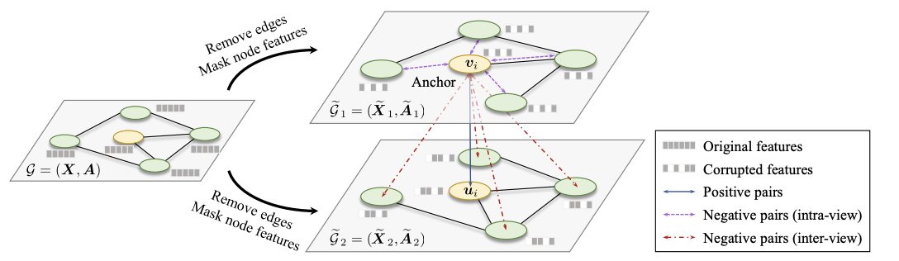
2.4 Contrastive Learning
Review-based recommendation :
contrasive learning

Slide 25
2.4 Contrastive Learning
Review-based recommendation :
contrasive learning

Slide 26
2.4 Contrastive Learning Module
Node Discrimination

Slide 27
2.4 Contrastive Learning Module
Node Discrimination
node
dropping
original graph

Slide 28
2.4 Contrastive Learning Module
Node Discrimination
node
dropping
original graph

Slide 29
2.4 Contrastive Learning Module
Node Discrimination
node
dropping
original graph

Slide 30
2.4 Contrastive Learning Module
Node Discrimination
node
dropping
original graph

Slide 31
2.4 Contrastive Learning Module
Node Discrimination
positive pair

Slide 32
2.4 Contrastive Learning Module
Node Discrimination
negative pair

Slide 33
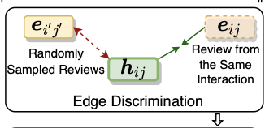
2.4 Contrastive Learning Module
Edge Discrimination

Slide 34
2.5 Model Optimization

Slide 35
Outline
● Introduction
● Related Work
● Method
● Experiment
● Conclusion

Slide 36
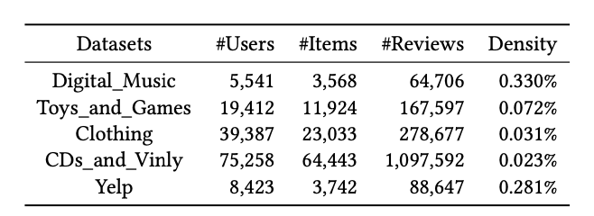
Datasets

Slide 37
Experiment-Baseline

Slide 38
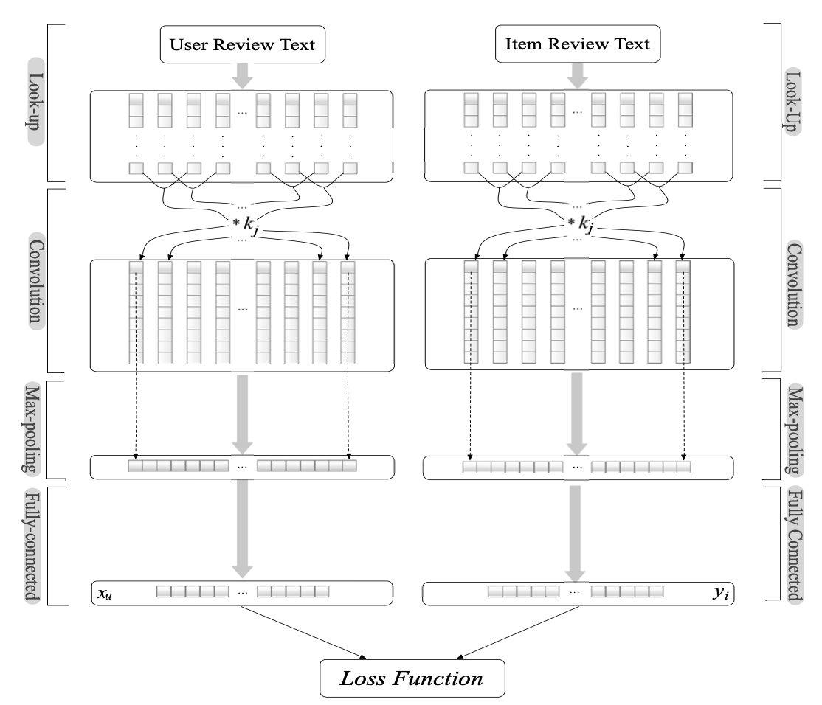
Experiment-Baseline
DeepCoNN
are merged into a single document
Word Representation

Slide 39
Experiment-Baseline
DeepCoNN
are merged into a single document
Word Representation
word embedding

Slide 40
Experiment-Baseline
DeepCoNN
are merged into a single document
Word Representation
word embedding

Slide 41
Experiment-Baseline
DeepCoNN
are merged into a single document
word embedding
filter
convolution
layer

Slide 42
Experiment-Baseline
DeepCoNN
are merged into a single document
word embedding
filter
max pooling

Slide 43
Experiment-Baseline
DeepCoNN
are merged into a single document
word embedding
filter
fully connected layer
Notes:
factorization：https://yulongtsai.medium.com/factorization-machine-63160bc2c06b

Slide 44
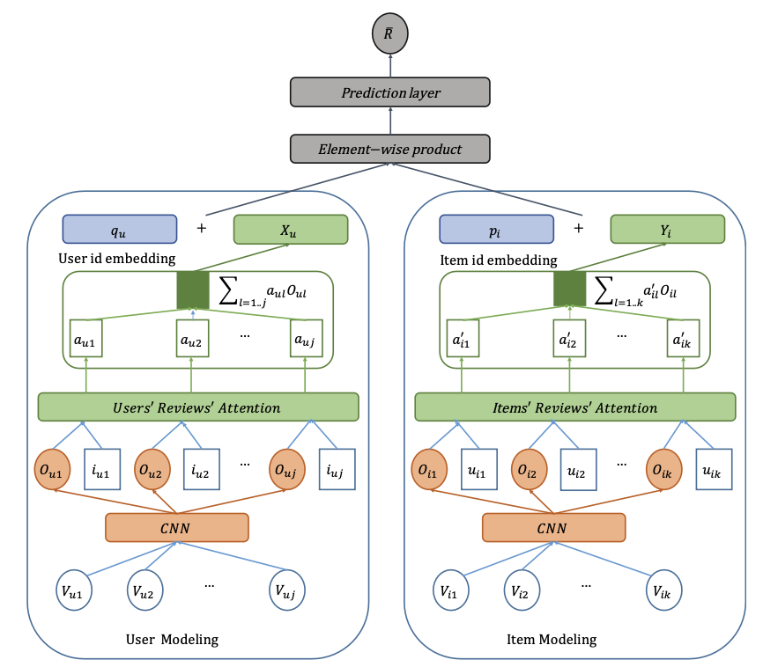
Experiment-Baseline
NARRE

Slide 45
Experiment-Baseline

Slide 46
Experiment-Baseline

Slide 47
Experiment - Different Data Sparsity

Slide 48
Experiment-The Effectiveness of RG

Slide 49
Experiment-The Effectiveness of RG

Slide 50
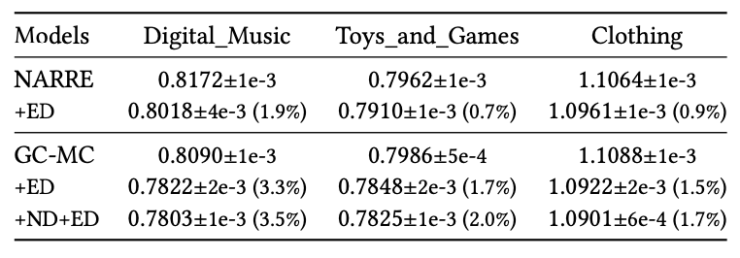
Experiment-The Effectiveness of CL task

Slide 51
Conclusion
designed a novel Review-aware Graph learning module (RG) to incorporate review information into user and item embedding learning
reviews were utilized to fine-tune the influences of corresponding neighbors and reviews themselves
two additional CL tasks (i.e., ED and ND) for better node embeddings and interaction modeling

